Slide 1
Tools and Techniques for Data Science

Slide 2
Introduction

Slide 3
Agenda
Definition of Data Science Cloud Computing and Big Data Tools in Data Science Techniques in Data Science

Slide 4
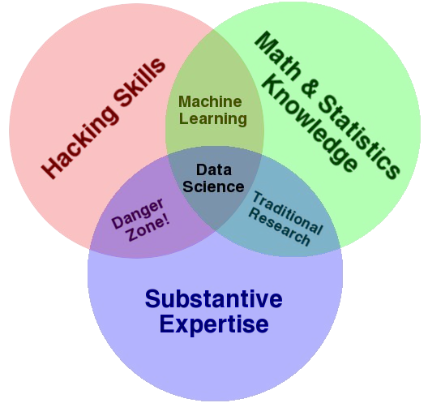
Definition of Data Science

Slide 5
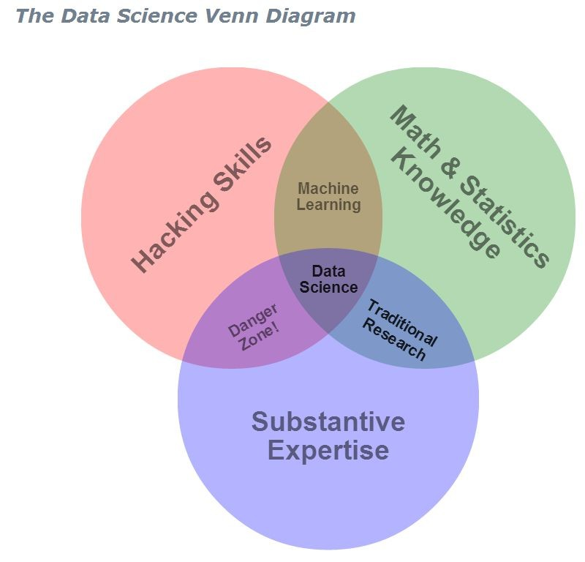
What is data science ?
Hacking ( Programming) + Maths/Statistics + Domain Knowledge = Data Science
http://drewconway.com/zia/2013/3/26/the-data-science-venn-diagram

Slide 6
What is a Data Scientist ?
a data scientist is simply a data analyst living in california

Slide 7
What is a Data Scientist
a data scientist is simply a person who can
write code
understand statistics
derive insights from data

Slide 8
Oh really, is this a Data Scientist ?
a data scientist is simply a person who can
write code = in
R,Python,Java, SQL, Hadoop (Pig,HQL,MR) etc
= for
data storage, querying, summarization, visualization
= how efficiently, and in time (fast results?)
= where
on databases, on cloud, servers
and
enough
understand
statistics
to
insights
derive
from data
so
business can make decisions

Slide 9
Cheat Sheets for Data Scientists
http://www.kdnuggets.com/2014/05/guide-to-data-science-cheat-sheets.html
a data scientist is simply a person who can write code in a few languages (primarily R, Python and SQL) for data querying, manipulation , aggregation, and visualization using enough statistical knowledge to give back actionable insights to the business for making decisions.
Since this rather practical definition of a data scientist is reinforced by the accompanying words on a job website for “data scientists” , ergo, here are some tools for learning the primary languages in data science- Python, R and SQL. A cheat sheet or reference card is a compilation of mostly used commands to help you learn that language’s syntax at a faster rate.

Slide 10
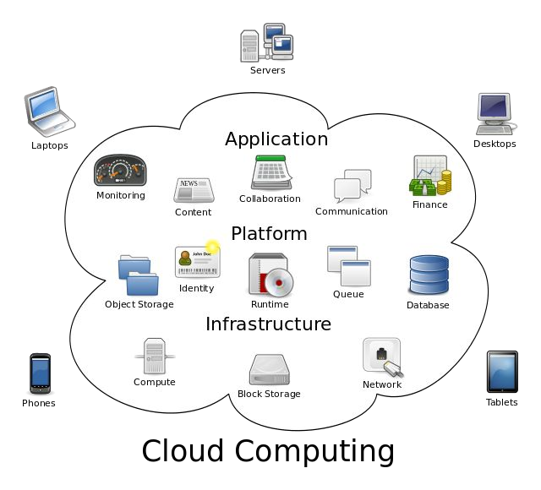
Cloud Computing
1. the practice of using a network of remote servers hosted on the Internet to store, manage, and process data, rather than a local server or a personal computer.
http://csrc.nist.gov/publications/nistpubs/800-145/SP800-145.pdf

Slide 11
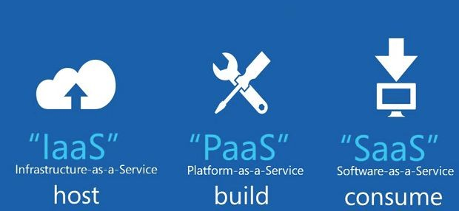
Cloud Computing
1. the practice of using a network of remote servers hosted on the Internet to store, manage, and process data, rather than a local server or a personal computer.
http://csrc.nist.gov/publications/nistpubs/800-145/SP800-145.pdf

Slide 12
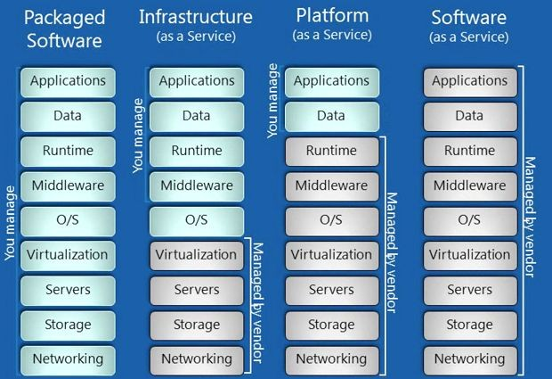
Cloud Computing

Slide 13
Introduction to Big Data
extremely large data sets that may be analysed computationally to reveal patterns, trends, and associations, especially relating to human behaviour and interactions.
Big data is a term that describes the large volume of data – both structured and unstructured – that inundates a business on a day-to-day basis. But it’s not the amount of data that’s important. It’s what organizations do with the data that matters. Big data can be analyzed for insights that lead to better decisions and strategic business moves.
http://www.sas.com/en_us/insights/big-data/what-is-big-data.html

Slide 14
The Three Vs of Big Data
industry analyst Doug Laney articulated the now-mainstream definition of big data as the three Vs:
Volume. Organizations collect data from a variety of sources, including business transactions, social media and information from sensor or machine-to-machine data. In the past, storing it would’ve been a problem – but new technologies (such as Hadoop) have eased the burden.
Velocity. Data streams in at an unprecedented speed and must be dealt with in a timely manner. RFID tags, sensors and smart metering are driving the need to deal with torrents of data in near-real time.
Variety. Data comes in all types of formats – from structured, numeric data in traditional databases to unstructured text documents, email, video, audio, stock ticker data and financial transactions.

Slide 15
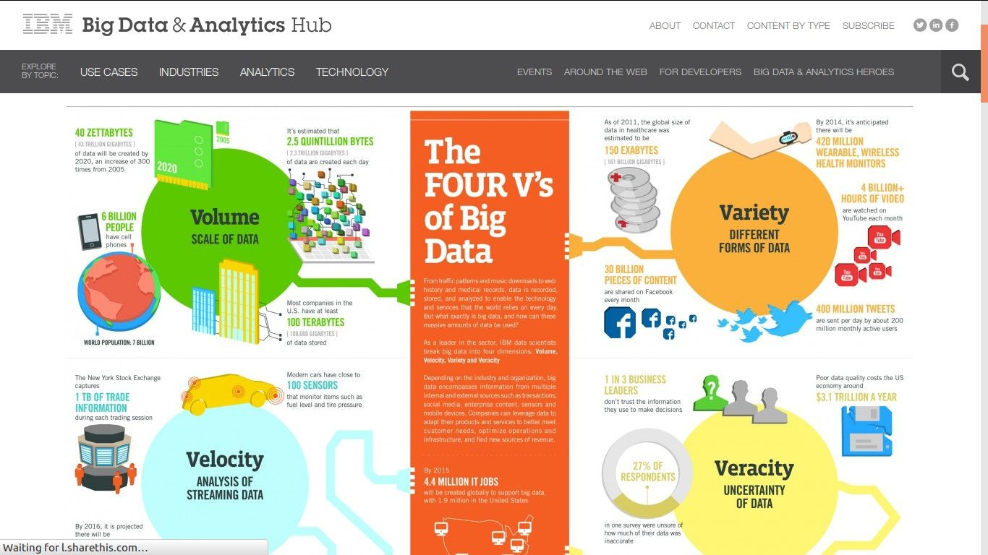
Big Data Facts
http://www.ibmbigdatahub.com/infographic/four-vs-big-data

Slide 16
Understanding Hadoop
The Apache Hadoop software library is a framework that allows for the distributed processing of large data sets across clusters of computers using simple programming models. It is designed to scale up from single servers to thousands of machines, each offering local computation and storage. Rather than rely on hardware to deliver high-availability, the library itself is designed to detect and handle failures at the application layer, so delivering a highly-available service on top of a cluster of computers, each of which may be prone to failures.
The project includes these modules:
Hadoop Common: The common utilities that support the other Hadoop modules.
Hadoop Distributed File System (HDFS™): A distributed file system that provides high-throughput access to application data.
Hadoop YARN: A framework for job scheduling and cluster resource management.
Hadoop MapReduce: A YARN-based system for parallel processing of large data sets.
http://hadoop.apache.org/

Slide 17
Understanding Hadoop
Other Hadoop-related projects at Apache include:
Ambari™: A web-based tool for provisioning, managing, and monitoring Apache Hadoop clusters which includes support for Hadoop HDFS, Hadoop MapReduce, Hive, HCatalog, HBase, ZooKeeper, Oozie, Pig and Sqoop. Ambari also provides a dashboard for viewing cluster health such as heatmaps and ability to view MapReduce, Pig and Hive applications visually alongwith features to diagnose their performance characteristics in a user-friendly manner.
Avro™: A data serialization system.
Cassandra™: A scalable multi-master database with no single points of failure.
Chukwa™: A data collection system for managing large distributed systems.
HBase™: A scalable, distributed database that supports structured data storage for large tables.
Hive™: A data warehouse infrastructure that provides data summarization and ad hoc querying.
Mahout™: A Scalable machine learning and data mining library.
Pig™: A high-level data-flow language and execution framework for parallel computation.
Spark™: A fast and general compute engine for Hadoop data. Spark provides a simple and expressive programming model that supports a wide range of applications, including ETL, machine learning, stream processing, and graph computation.
Tez™: A generalized data-flow programming framework, built on Hadoop YARN, which provides a powerful and flexible engine to execute an arbitrary DAG of tasks to process data for both batch and interactive use-cases. Tez is being adopted by Hive™, Pig™ and other frameworks in the Hadoop ecosystem, and also by other commercial software (e.g. ETL tools), to replace Hadoop™ MapReduce as the underlying execution engine.
ZooKeeper™: A high-performance coordination service for distributed applications.

Slide 18
Why Learn Hadoop
Hadoop, however, is specifically designed to have a very flat scalability curve. After a Hadoop program is written and functioning on ten nodes, very little--if any--work is required for that same program to run on a much larger amount of hardware.
MapReduce: Isolated Processes
Hadoop limits the amount of communication which can be performed by the processes, as each individual record is processed by a task in isolation from one another. While this sounds like a major limitation at first, it makes the whole framework much more reliable
In a Hadoop cluster, data is distributed to all the nodes of the cluster as it is being loaded in. The Hadoop Distributed File System (HDFS) will split large data files into chunks which are managed by different nodes in the cluster. In addition to this each chunk is replicated across several machines, so that a single machine failure does not result in any data being unavailable.
https://developer.yahoo.com/hadoop/tutorial/module1.html

Slide 19
HDFS
HDFS, the Hadoop Distributed File System, is a distributed file system designed to hold very large amounts of data (terabytes or even petabytes), and provide high-throughput access to this information. Files are stored in a redundant fashion across multiple machines to ensure their durability to failure and high availability to very parallel applications.
HDFS is a block-structured file system: individual files are broken into blocks of a fixed size. These blocks are stored across a cluster of one or more machines with data storage capacity. Individual machines in the cluster are referred to as DataNodes. A file can be made of several blocks, and they are not necessarily stored on the same machine; the target machines which hold each block are chosen randomly on a block-by-block basis. Thus access to a file may require the cooperation of multiple machines, but supports file sizes far larger than a single-machine DFS; individual files can require more space than a single hard drive could hold.
https://developer.yahoo.com/hadoop/tutorial/module2.html

Slide 20
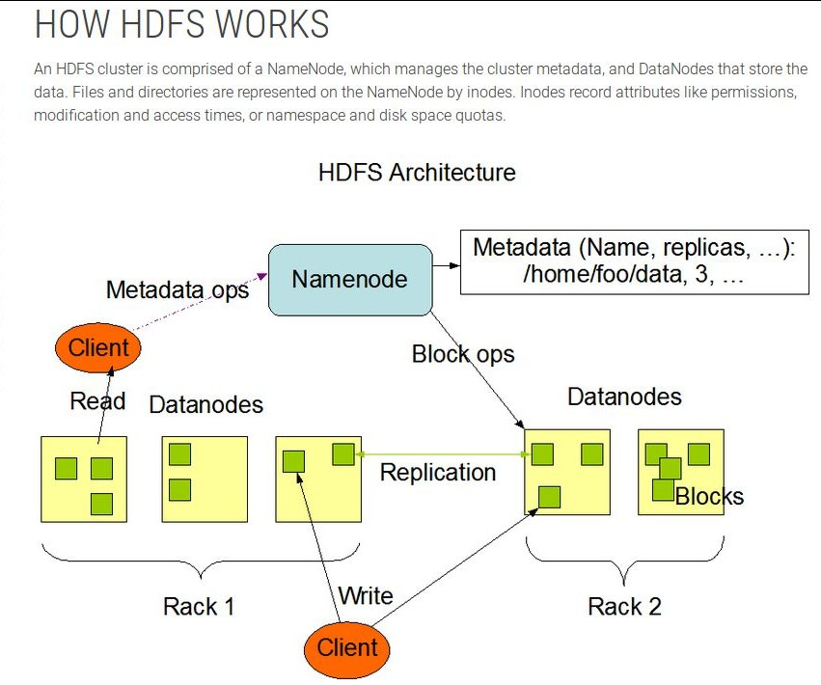
HDFS

Slide 21
Five Daemons of Hadoop
NameNode- the Master node which is responsible for storing the meta-data for all the files and directories. It has information such as the blocks that make a file, and where are those blocks located in the cluster.
Secondary NameNode- It periodically merges changes in the NameNode with the edit log so that it doesn’t grow too large in size. It also keeps a copy of the image which can be used in case of failure of NameNode.
DataNode - Stores actual HDFS data blocks.
JobTracker -JobTracker is the daemon service for submitting and tracking MapReduce jobs in Hadoop. There is only One Job Tracker process run on any hadoop cluster.
TaskTracker -A TaskTracker is a slave node daemon in the cluster that accepts tasks (Map, Reduce and Shuffle operations) from a JobTracker. There is only One Task Tracker process run on any hadoop slave node.
Following 3 Daemons run on Master nodes NameNode - Secondary NameNode - JobTracker - Following 2 Daemons run on each Slave nodes DataNode . TaskTracker http://www.fromdev.com/2010/12/interview-questions-hadoop-mapreduce.html

Slide 22
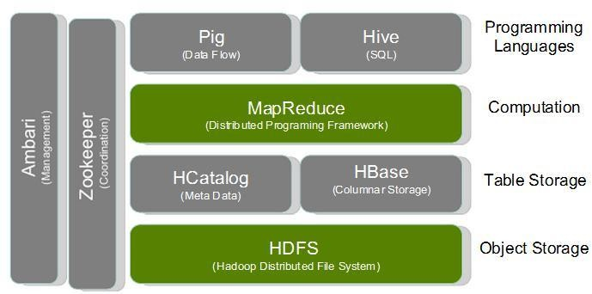
Big Data: Hadoop Stack

Slide 23
NoSQL
A NoSQL (Not-only-SQL) database is one that has been designed to store, distribute and access data using methods that differ from relational databases (RDBMS’s). NoSQL technology was originally created and used by Internet leaders such as Facebook, Google, Amazon, and others who required database management systems that could write and read data anywhere in the world, while scaling and delivering performance across massive data sets and millions of users.

Slide 24
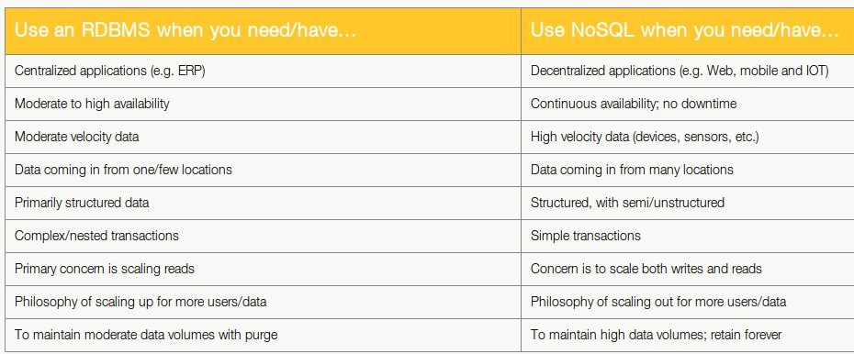
NoSQL
https://www.datastax.com/nosql-databases

Slide 25
Basic Statistics
Some of the basic statistics that every data scientist should know are given here. This assumes rudimentary basic knowledge of statistics ( like measures of central tendency or variation) and basic familiarity with some of the terminology used by statisticians.
Random Sampling- In truly random sampling,the sample should be representative of the entire data. RAndom sampling remains of relevance in the era of Big Data and Cloud Computing
Distributions- A data scientist should know the distributions ( normal, Poisson, Chi Square, F) and also how to determine the distribution of data.
Hypothesis Testing - Hypothesis testing is meant for testing assumptions statistically regarding values of central tendency (mean, median) or variation. A good example of an easy to use software for statistical testing is the “test” tab in the Rattle GUI in R.
Outliers- Checking for outliers is a good way for a data scientist to see anomalies as well as identify data quality. The box plot (exploratory data analysis) and the outlierTest function from car package ( Bonferroni Outlier Test) is how statistical rigor can be maintained to outlier detection.

Slide 26
Basic Techniques
Some of the basic techniques that a data scientist must know are listed as follows-
Text Mining - In text mining , text data is analyzed for frequencies, associations and corelation for predictive purposes. The tm package from R greatly helps with text mining.
Sentiment Analysis- In sentiment analysis the text data is classified based on a sentiment lexicography ( eg which says happy is less positive than delighted but more positive than sad) to create sentiment scores of the text data mined.
Social Network Analysis- In social network analysis, the direction of relationships, the quantum of messages and the study of nodes,edges and graphs is done to give insights..
Time Series Forecasting- Data is said to be auto regressive with regards to time if a future value is dependent on a current value for a variable. Technqiues such as ARIMA and exponential smoothing and R packages like forecast greatly assist in time series forecasting.
Web Analytics
Social Media Analytics
Data Mining or Machine Learning

Slide 27
Data Science Tools
R
Python
Tableau
Spark with ML
Hadoop (Pig and Hive)
SAS
SQL

Slide 28
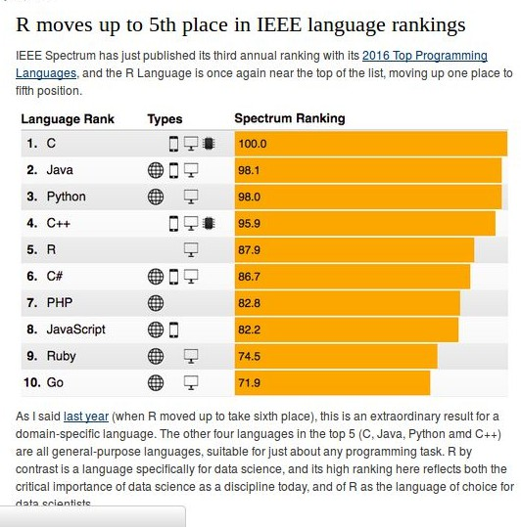
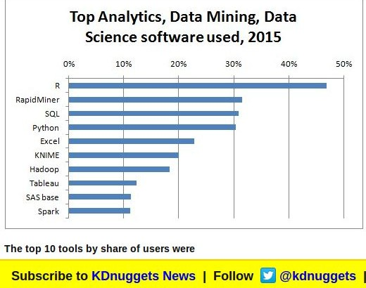
Data Science with R
A popular language in Data Science

Slide 29
What Is R
https://www.r-project.org/about.html
R is an integrated suite of software facilities for data manipulation, calculation and graphical display. It includes
an effective data handling and storage facility,
a suite of operators for calculations on arrays, in particular matrices,
a large, coherent, integrated collection of intermediate tools for data analysis,
graphical facilities for data analysis and display either on-screen or on hardcopy, and
a well-developed, simple and effective programming language which includes conditionals, loops, user-defined recursive functions and input and output facilities.

Slide 30
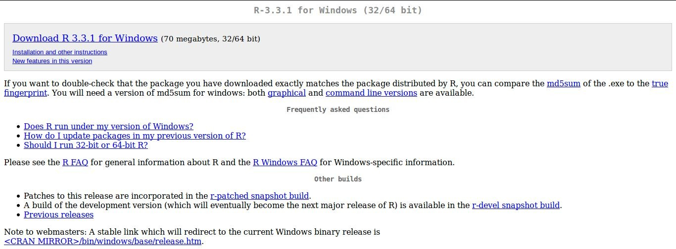
Install R
https://cran.r-project.org/bin/windows/base/

Slide 31
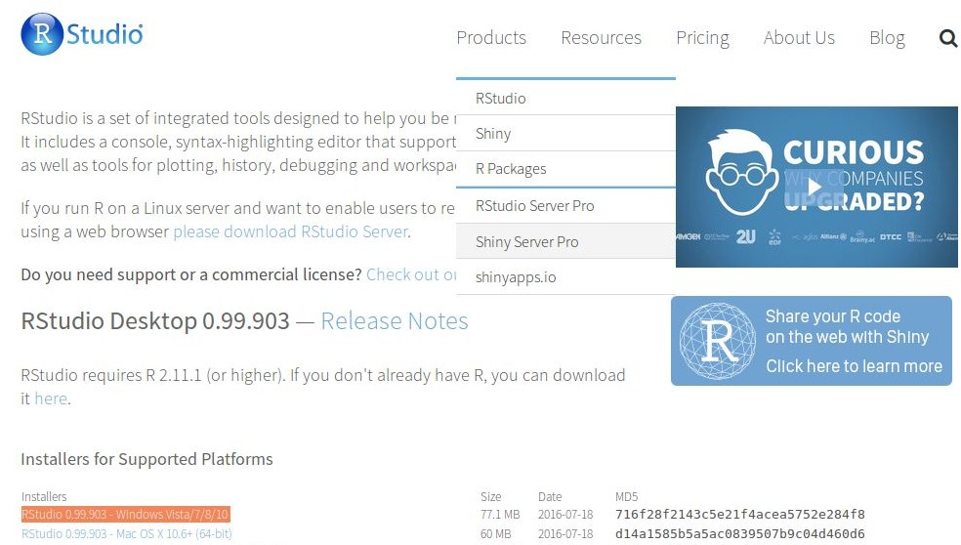
Install RStudio
https://www.rstudio.com/products/rstudio/download/

Slide 32

Statistical Software Landscape
SAS
Python (Pandas) IBM SPSS
R
Julia Clojure Octave
Matlab JMP
E views

Slide 33
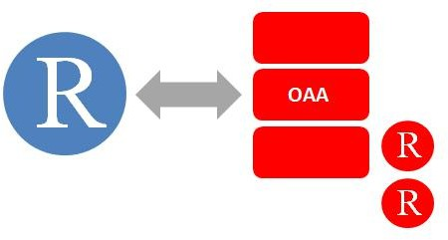
Using R with other software
https://rforanalytics.wordpress.com/useful-links-for-r/using-r-from-other-software/
Tableau http://www.tableausoftware.com/new-features/r-integration
Qlik http://qliksolutions.ru/qlikview/add-ons/r-connector-eng/
Oracle R http://www.oracle.com/technetwork/database/database-technologies/r/r-enterprise/overview/index.html Rapid Miner https://rapid-i.com/content/view/202/206/lang,en/#r
JMP http://blogs.sas.com/jmp/index.php?/archives/298-JMP-Into-R!.html

Slide 34
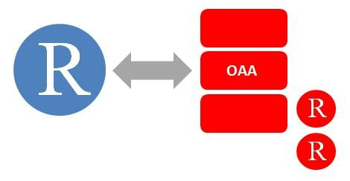
Using R with other software
https://rforanalytics.wordpress.com/useful-links-for-r/using-r-from-other-software/
SAS/IML http://www.sas.com/technologies/analytics/statistics/iml/index.html
Teradata http://developer.teradata.com/applications/articles/in-database-analytics-with-teradata-r Pentaho http://bigdatatechworld.blogspot.in/2013/10/integration-of-rweka-with-pentaho-data.html
IBM SPSS
https://www14.software.ibm.com/webapp/iwm/web/signup.do?source=ibm-analytics&S_PKG=ov18855&S_TACT=M161003W&dy nform=127&lang=en_US
TIBCO TERR
http://spotfire.tibco.com/discover-spotfire/what-does-spotfire-do/predictive-analytics/tibco-enterprise-runtime-for-r-terr

Slide 35
Some Advantages of R
open source free
large number of algorithms and packages esp for statistics flexible
very good for data visualization superb community
rapidly growing
can be used with other software

Slide 36
Some Disadvantages of R
in memory (RAM) usage steep learning curve
some IT departments frown on open source verbose documentation
tech support
evolving ecosystem for corporates

Slide 37
Solutions for Disadvantages of R
in memory (RAM) usage steep learning curve
specialized packages, in database computing TRAINING !!!
some IT departments frown on open source TRAINING and education!
verbose documentation tech support
CRAN View , R Documentation expanding pool of resources
evolving ecosystem for corporates getting better with MS et al

Slide 38



•
•
•
•

Slide 39


•
•
•
•
•
•

Slide 40
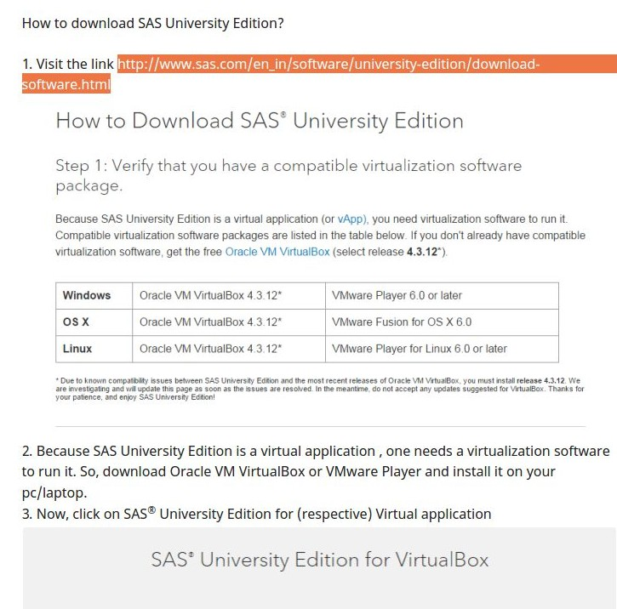
http://www.sas.com/en_in/software/university-edition/download-software.html

Slide 41


•
•
–
–
–
•

Slide 42

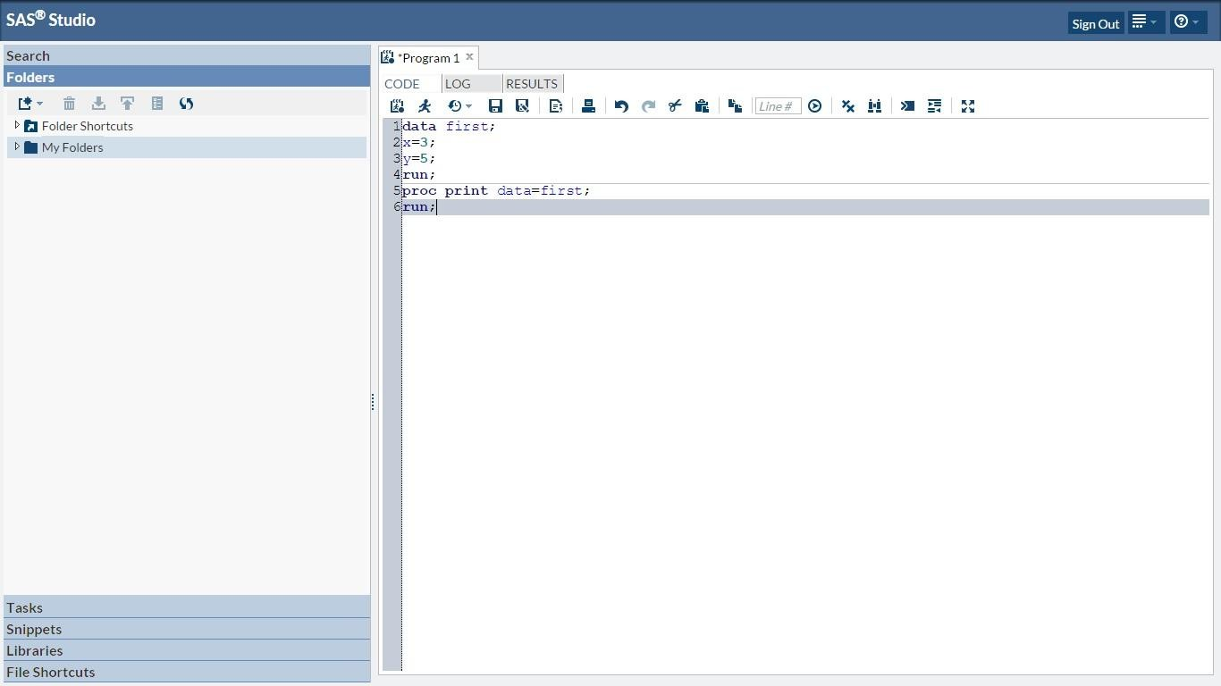

Slide 43

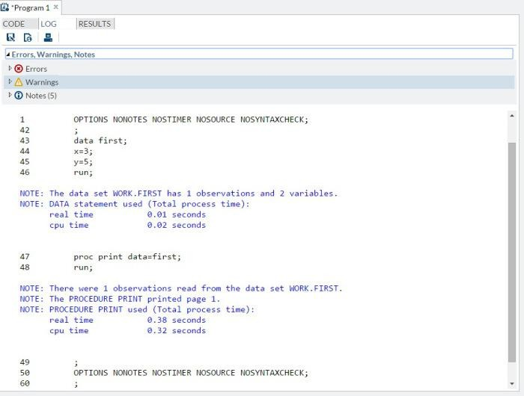

Slide 44

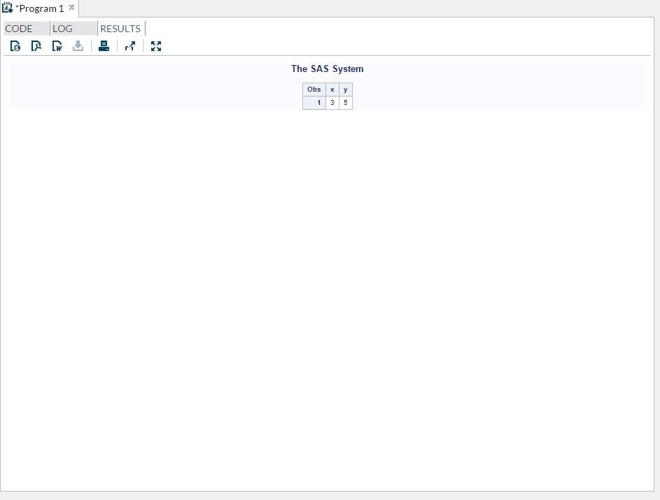

Slide 45
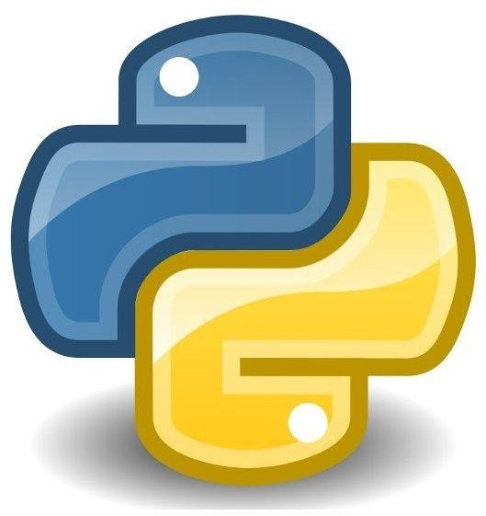
Python

Slide 46
What is Python
Python is a widely used general-purpose, high-level programming languagn
Its design philosophy emphasizes code readability, and its syntax allows programmers to express concepts in fewer lines of code than would be possible in languages such as C++ or Java.
Python is used widely
https://www.python.org/about/success/

Slide 47
Object Oriented Programming (OOPS)
a computer program consists of, such as variables, expressions, functions or modules.
name = ajay print (name) import printer Hi I am %name
Object-oriented programming (OOP) is a programming paradigm based on the concept of "objects", which are data structures that contain data, in the form off ields, often known as attributes; and code, in the form of procedures, often known as methods.
Dynamic programming language is a term used in computer science to describe a class of high-level programming languageswhich, at runtime, execute many common programming behaviors that static programming languages perform during compilation.
"compiler" is primarily used for programs that translate source code from a high-level programming language to a lower level language (e.g., assembly language or machine code).

Slide 48
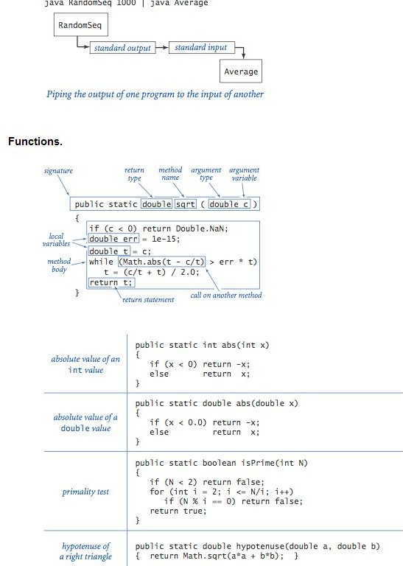
Java
http://introcs.cs.princeton.edu/java/11cheatsheet/

Slide 49
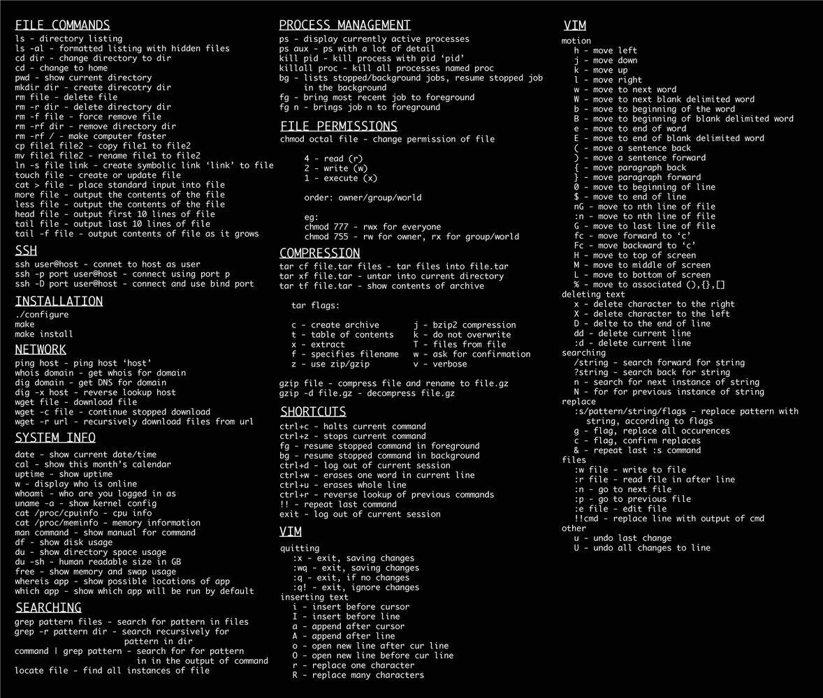
Linux
http://www.linuxstall.com/linux-command-line-tips-that-every-linux-user-should-know/

Slide 50
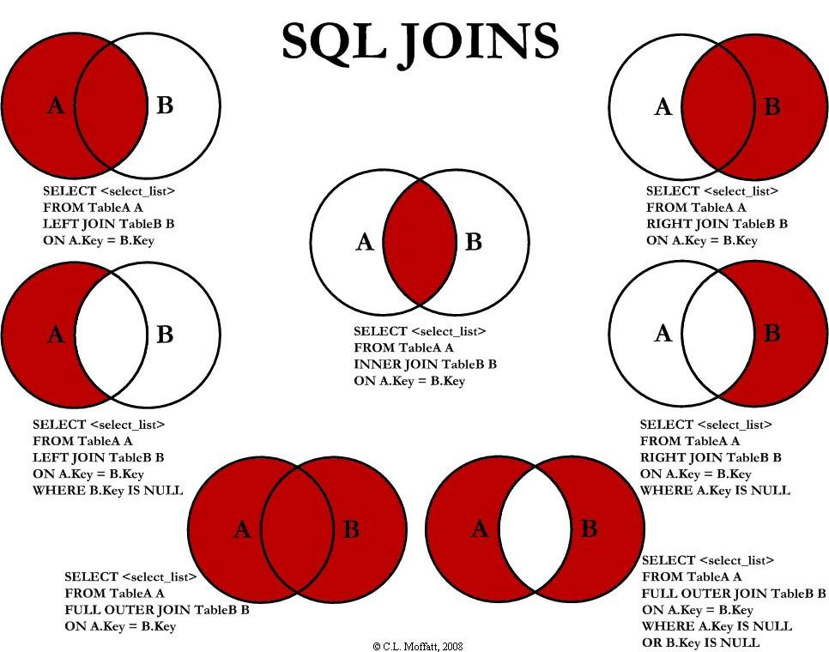
SQL
http://www.codeproject.com/Articles/33052/Visual-Representation-of-SQL-Joins

Slide 51
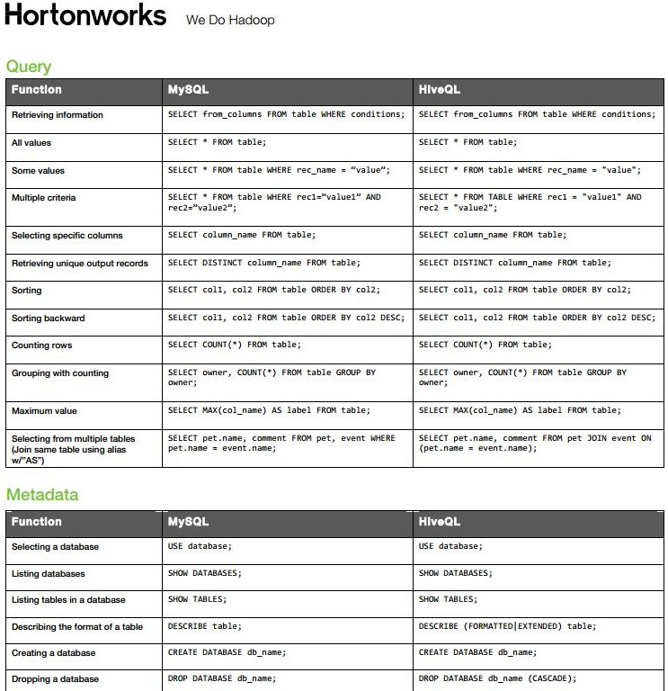
Hive QL
http://hortonworks.com/wp-content/uploads/downloads/2013/08/Hortonworks.CheatSheet.SQLtoHive.pdf

Slide 52
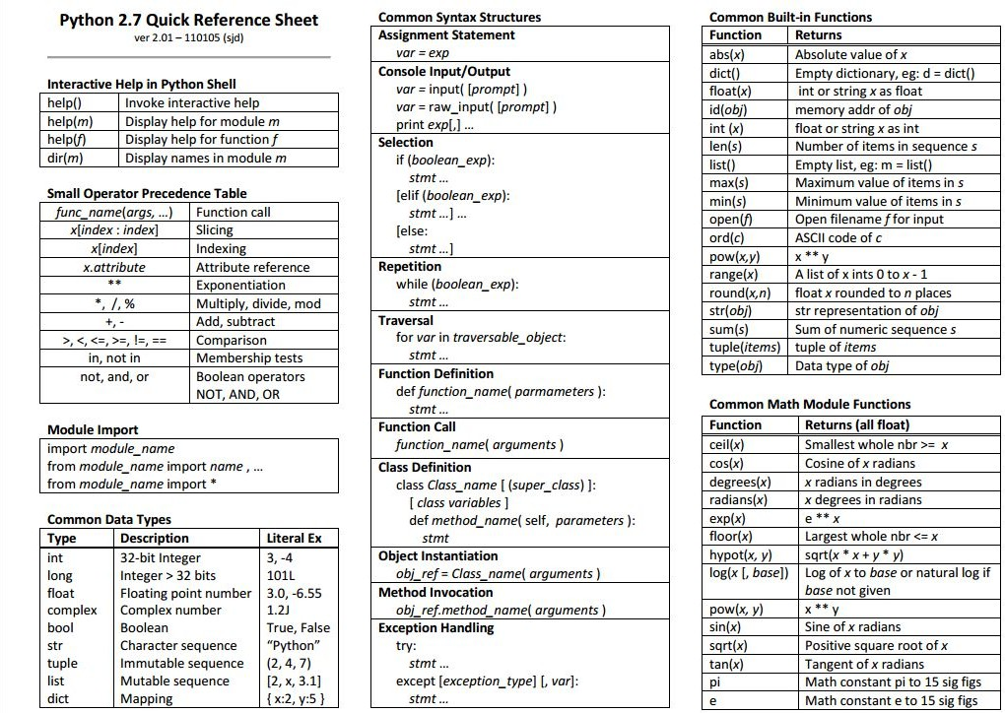
Python
http://www.astro.up.pt/~sousasag/Python_For_Astronomers/Python_qr.pdf

Slide 53
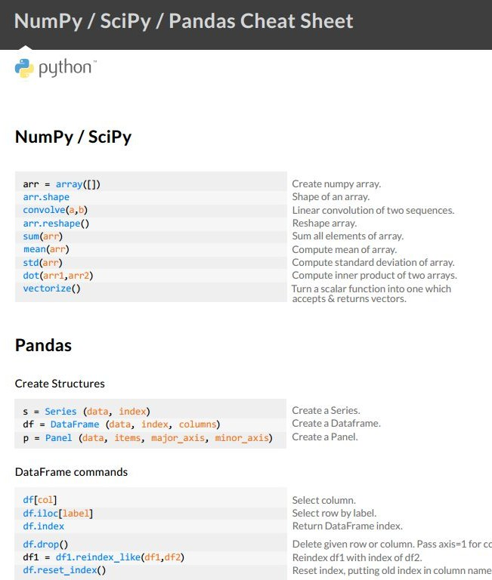
Python
https://s3.amazonaws.com/quandl-static-content/Documents/Quandl+-+Pandas,+SciPy,+NumPy+Cheat+Sheet.pdf

Slide 54
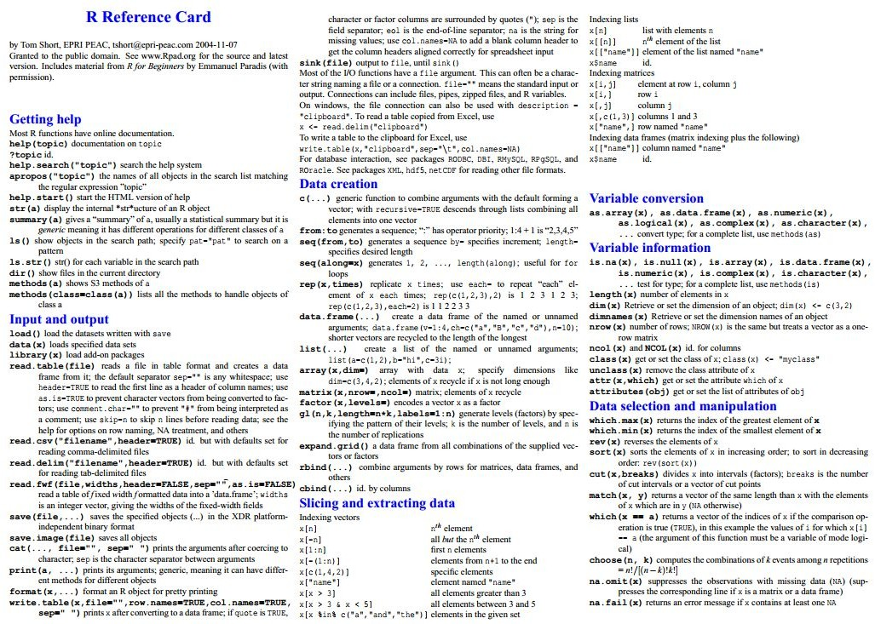
http://cran.r-project.org/doc/contrib/Short-refcard.pdf
R

Slide 55
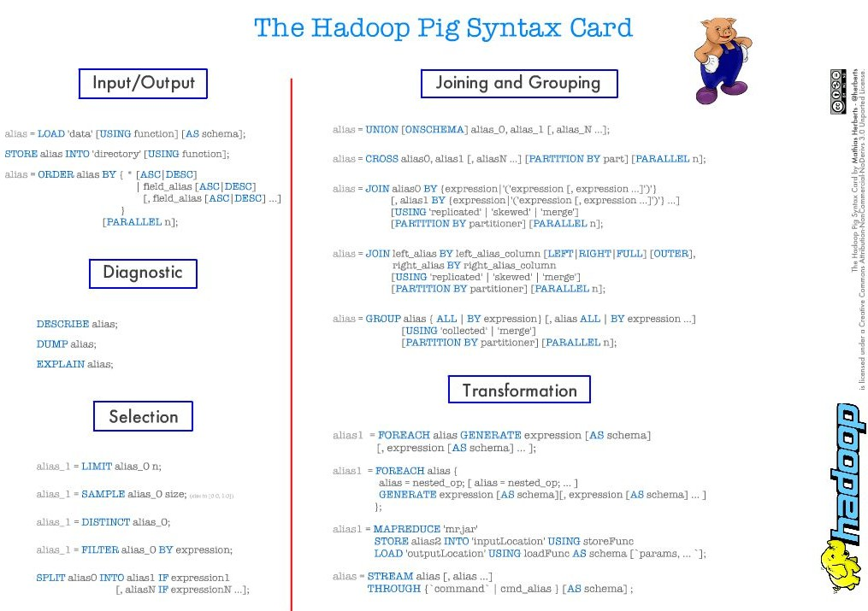
Pig

Slide 56
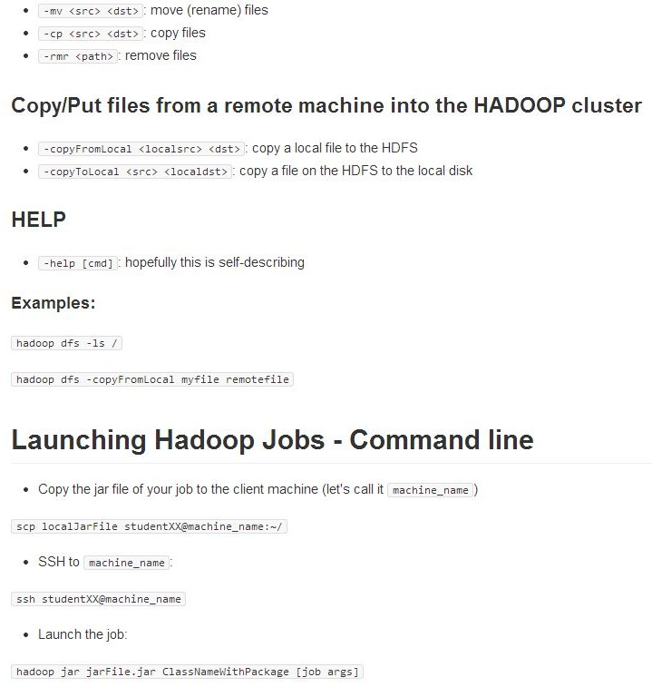
HDFS
https://github.com/michiard/CLOUDS-LAB/blob/master/C-S.md

Slide 57
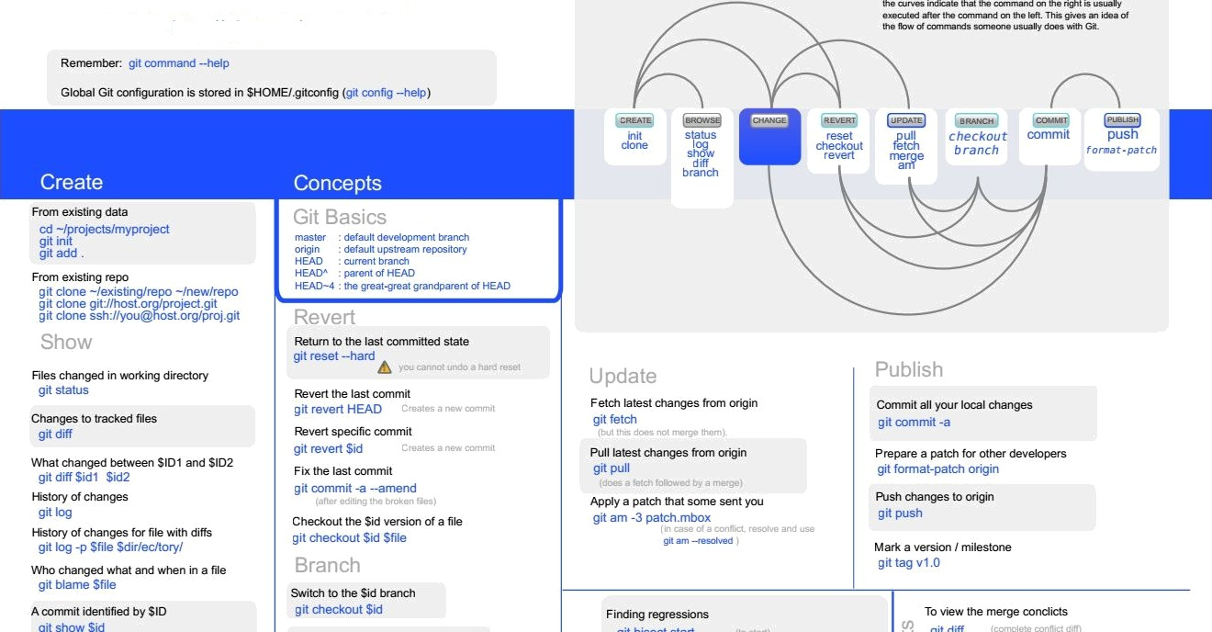
Git Cheat Sheet
http://git.or.cz/

Slide 58
All together now
PIG http://www.slideshare.net/Mathias-Herberts/hadoop-pig-syntax-card HDFS https://github.com/michiard/CLOUDS-LAB/blob/master/C-S.md
R http://cran.r-project.org/doc/contrib/Short-refcard.pdf
Python https://s3.amazonaws.com/quandl-static-content/Documents/Quandl+-+Pandas,+SciPy,+NumPy+Cheat+Sheet.pdf Python http://www.astro.up.pt/~sousasag/Python_For_Astronomers/Python_qr.pdf
Java http://introcs.cs.princeton.edu/java/11cheatsheet/
Linux http://www.linuxstall.com/linux-command-line-tips-that-every-linux-user-should-know/ SQL http://www.codeproject.com/Articles/33052/Visual-Representation-of-SQL-Joins
Git http://overapi.com/static/cs/git-cheat-sheet.pdf

Slide 59
R provides a wide variety of statistical (linear and nonlinear modelling, classical statistical tests, time-series analysis, classification, clustering, …) and graphical techniques, and is highly extensible.
R
R is an integrated suite of software facilities for data manipulation, calculation and graphical display. It includes an effective data handling and storage facility, a suite of operators for calculations on arrays, in particular matrices, a large, coherent, integrated collection of intermediate tools for data analysis, graphical facilities for data analysis and display either on-screen or on hardcopy, and a well-developed, simple and effective programming language
https://www.r-project.org/about.html

Slide 60
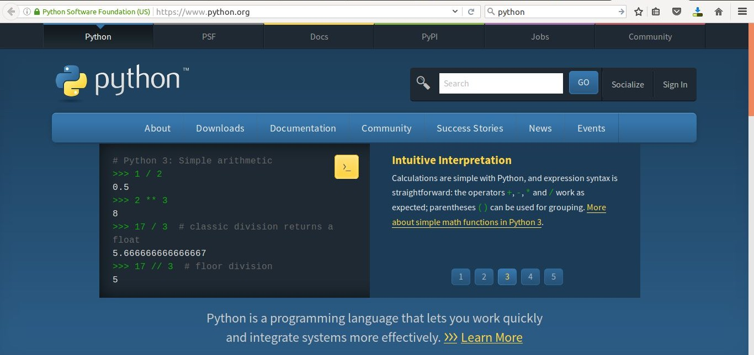
Python
http://python-history.blogspot.in/ and https://www.python.org/

Slide 61
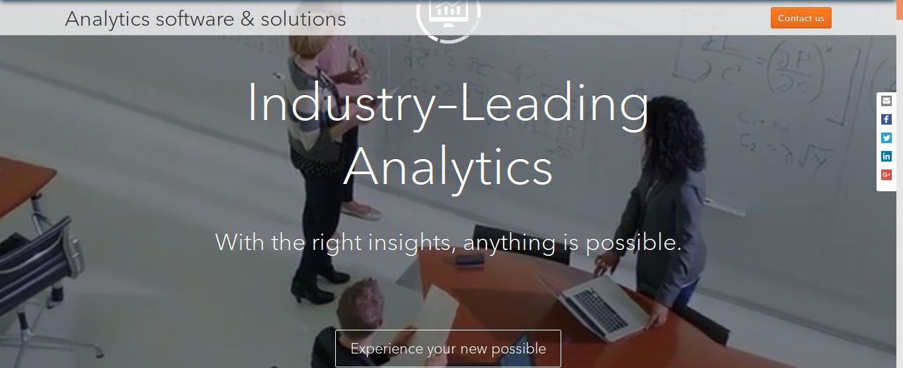
SAS
http://www.sas.com/en_in/home.html

Slide 62
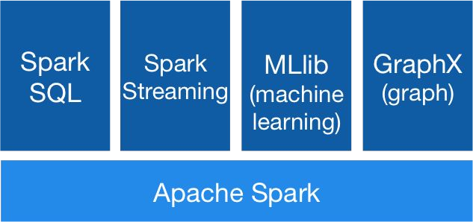
Big Data: Hadoop Stack with Spark
http://spark.apache.org/ Apache Spark™ is a fast and general engine for large-scale data processing.

Slide 63
Big Data: Hadoop Stack with Mahout
https://mahout.apache.org/
The Apache Mahout™ project's goal is to build an environment for quickly creating scalable performant machine learning applications.
Apache Mahout Samsara Environment includes
Distributed Algebraic optimizer
R-Like DSL Scala API
Linear algebra operations
Ops are extensions to Scala
IScala REPL based interactive shell
Integrates with compatible libraries like MLLib
Runs on distributed Spark, H2O, and Flink
Apache Mahout Samsara Algorithms included
Stochastic Singular Value Decomposition (ssvd, dssvd)
Stochastic Principal Component Analysis (spca, dspca)

Slide 64
Big Data: Hadoop Stack with Mahout
https://mahout.apache.org/
Apache Mahout software provides three major features:
A simple and extensible programming environment and framework for building scalable algorithms
A wide variety of premade algorithms for Scala + Apache Spark, H2O, Apache Flink
Samsara, a vector math experimentation environment with R-like syntax which works at scale

Slide 65
Data Science Techniques
Machine Learning
Regression
Logistic Regression
K Means Clustering
Association Analysis
Decision Trees
Text Mining
Social Network Analysis
Time Series Forecasting
LTV and RFM Analysis
Pareto Analysis

Slide 66
What is an algorithm
a process or set of rules to be followed in calculations or other problem-solving operations, especially by a computer.
a self-contained step-by-step set of operations to be performed
a procedure or formula for solving a problem, based on conducting a sequence of specified action
a procedure for solving a mathematical problem (as of finding the greatest common divisor) in a finite number of steps that frequently involves repetition of an operation; broadly : a step-by-step procedure for solving a problem or accomplishing some end especially by a computer.

Slide 67
Machine Learning
Machine learning concerns the construction and study of systems that can learn from data. For example, a machine learning system could be trained on email messages to learn to distinguish between spam and non-spam messages
Supervised learning is the machine learning task of inferring a function from labeled training data.^{[1]} The training data consist of a set of training examples. In supervised learning, each example is a pair consisting of an input object (typically a vector) and a desired output value (also called the supervisory signal).
In the terminology of machine learning, classification is considered an instance of supervised learning, i.e. learning where a training set of correctly identified observations is available.
In machine learning, the problem of unsupervised learning is that of trying to find hidden structure in unlabeled data. Since the examples given to the learner are unlabeled, there is no error or reward signal to evaluate a potential solution. This distinguishes unsupervised learning from supervised learning
The corresponding unsupervised procedure is known as clustering or cluster analysis, and involves grouping data into categories based on some measure of inherent similarity (e.g. the distance between instances, considered as vectors in a multi-dimensional vector space).

Slide 68
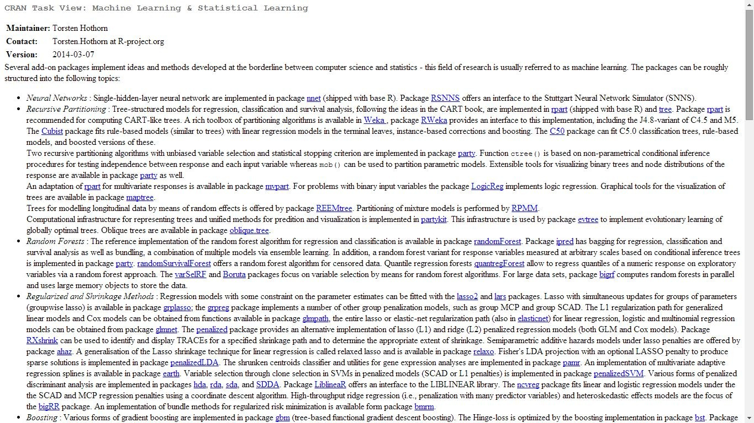
CRAN VIEW Machine Learning
http://cran.r-project.org/web/views/MachineLearning.html

Slide 69
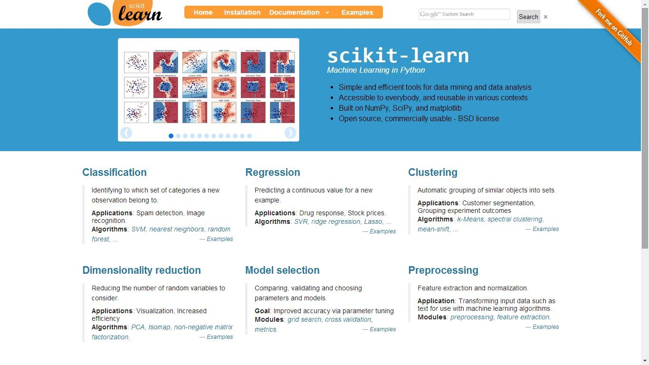
Machine Learning in Python
http://scikit-learn.org/stable/

Slide 70
Classification
In machine learning and statistics, classification is the problem of identifying to which of a set of categories (sub-populations) a new observation belongs, on the basis of a training set of data containing observations (or instances) whose category membership is known.
The individual observations are analyzed into a set of quantifiable properties, known as various explanatory variables,features, etc.
These properties may variously be categorical (e.g. "A", "B", "AB" or "O", for blood type),
ordinal (e.g. "large", "medium" or "small"),
integer-valued (e.g. the number of occurrences of a part word in an email) or
real-valued (e.g. a measurement of blood pressure).
Some algorithms work only in terms of discrete data and require that real-valued or integer-valued data be discretized into groups (e.g. less than 5, between 5 and 10, or greater than 10).

Slide 71
Regression
regression analysis is a statistical process for estimating the relationships among variables. It includes many techniques for modeling and analyzing several variables, when the focus is on the relationship between
a dependent variable and one or more independent variables.
More specifically, regression analysis helps one understand how the typical value of the dependent variable (or 'criterion variable') changes when any one of the independent variables is varied, while the other independent variables are held fixed.
Most commonly, regression analysis estimates the conditional expectation of the dependent variable given the independent variables – that is, the average value of the dependent variable when the independent variables are fixed. Less commonly, the focus is on a quantile, or other location parameter of the conditional distribution of the dependent variable given the independent variables.

Slide 72
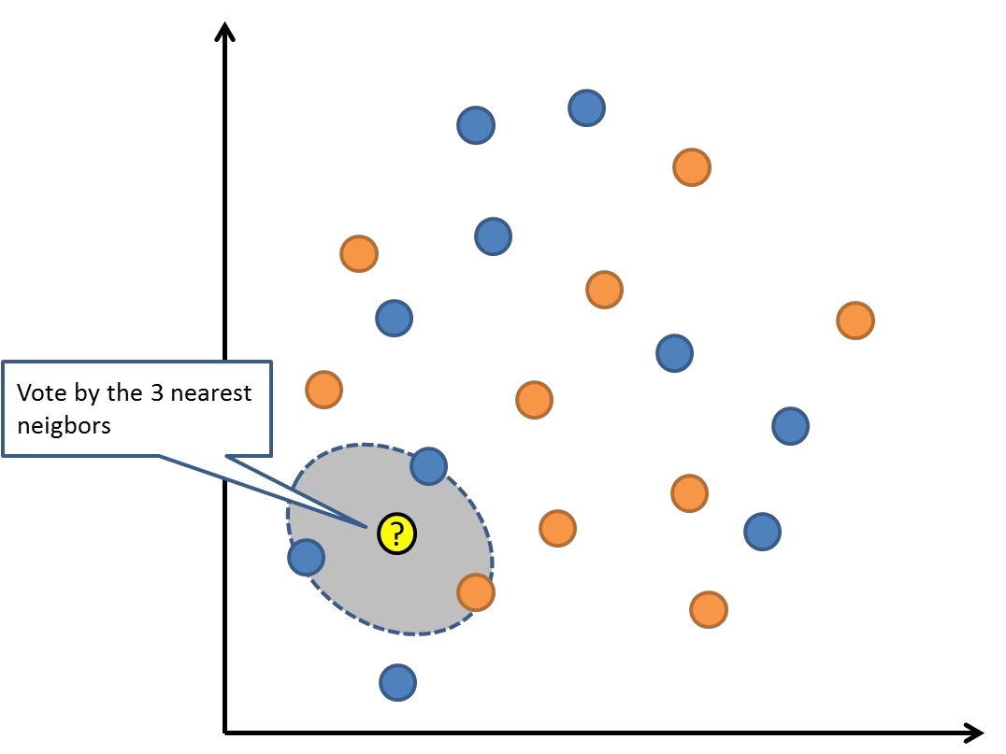
kNN

Slide 73
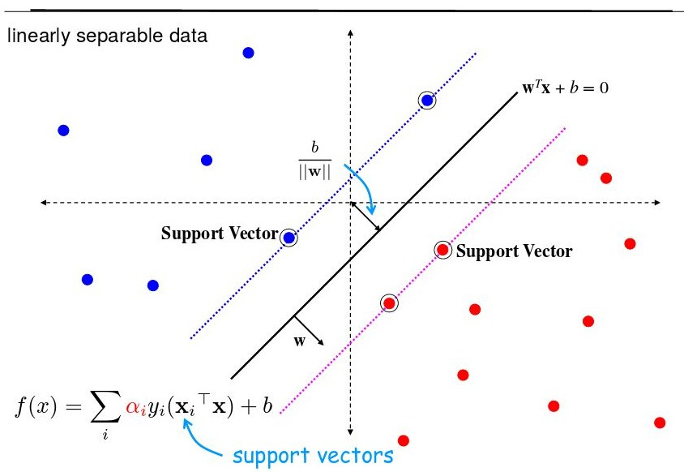
Support Vector Machines
http://axon.cs.byu.edu/Dan/678/miscellaneous/SVM.example.pdf

Slide 74
Association Rules
http://en.wikipedia.org/wiki/Association_rule_learning
Based on the concept of strong rules, Rakesh Agrawal et al.^{[2]} introduced association rules for discovering regularities between products in large-scale transaction data recorded by point-of-sale (POS) systems in supermarkets.
For example, the rule found in the sales data of a supermarket would indicate that if a customer buys onions and potatoes together, he or she is likely to also buy hamburger meat. Such information can be used as the basis for decisions about marketing activities such as, e.g., promotional pricing or product placements.
In addition to the above example from market basket analysis association rules are employed today in many application areas including Web usage mining, intrusion detection, Continuous production, and bioinformatics. As opposed to sequence mining, association rule learning typically does not consider the order of items either within a transaction or across transactions
Conecpts- Support, Confidence, Lift In R
apriori() in arules package In Python
http://orange.biolab.si/docs/latest/reference/rst/Orange.associate/

Slide 75
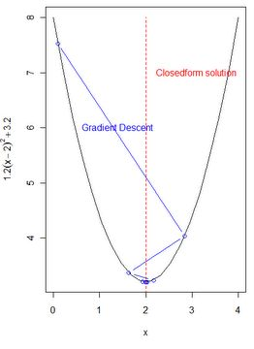
Gradient Descent
Gradient descent is a first-order iterative optimization algorithm. To find a local minimum of a function using gradient descent, one takes steps proportional to the negative of the gradient (or of the approximate gradient) of the function at the current point.
http://econometricsense.blogspot.in/2011/11/gradient-descent-in-r.html
Start at some x value, use derivative at that value to tell us which way to move, and repeat. Gradient descent.
http://www.cs.colostate.edu/%7Eanderson/cs545/Lectures/week6day2/week6day2.pdf

Slide 76
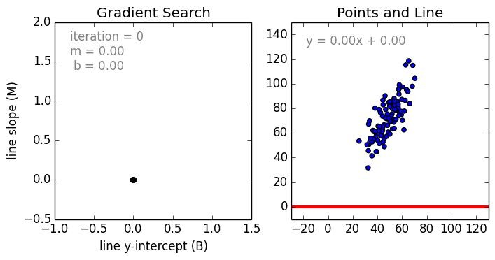
Gradient Descent
https://spin.atomicobject.com/2014/06/24/gradient-descent-linear-regression/ A standard approach to
solving this type of problem is to define an error function (also called a cost function)
that measures how “good” a given line is.
initial_b = 0 # initial y-intercept guess initial_m = 0 # initial slope guess num_iterations = 1000

Slide 77
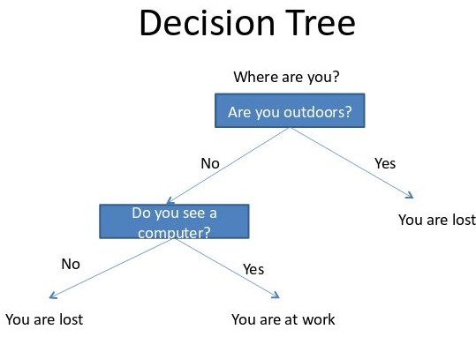
Decision Trees
http://select.cs.cmu.edu/class/10701-F09/recitations/recitation4_decision_tree.pdf

Slide 78
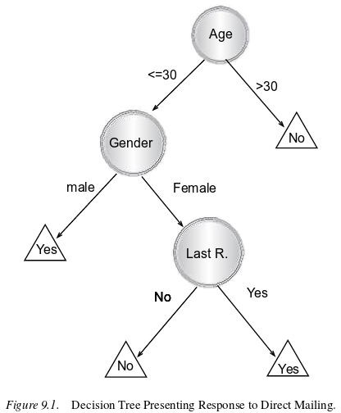
Decision Trees
Http://www.ise.bgu.ac.il/faculty/liorr/hbchap9.pdf

Slide 79
Random Forest
Random Forests grows many classification trees. To classify a new object from an input vector, put the input vector down each of the trees in the forest. Each tree gives a classification, and we say the tree "votes" for that class. The forest chooses the classification having the most votes (over all the trees in the forest).
Each tree is grown as follows:
If the number of cases in the training set is N, sample N cases at random - but with replacement, from the original data. This sample will be the training set for growing the tree.
If there are M input variables, a number m<<M is specified such that at each node, m variables are selected at random out
of the M and the best split on these m is used to split the node. The value of m is held constant during the forest growing.
Each tree is grown to the largest extent possible. There is no pruning.
In the original paper on random forests, it was shown that the forest error rate depends on two things:
  The correlation between any two trees in the forest. Increasing the correlation increases the forest error rate.
  The strength of each individual tree in the forest. A tree with a low error rate is a strong classifier. Increasing the strength of the individual trees decreases the forest error rate.
https://www.stat.berkeley.edu/~breiman/RandomForests/cc_home.htm#intro

Slide 80
Bagging
Bagging, aka bootstrap aggregation, is a relatively simple way to increase the power of a predictive statistical model by taking multiple random samples(with replacement) from your training data set, and using each of these samples to construct a separate model and separate predictions for your test set. These predictions are then averaged to create a, hopefully more accurate, final prediction value.
http://www.vikparuchuri.com/blog/build-your-own-bagging-function-in-r/

Slide 81
Boosting
Boosting is one of several classic methods for creating ensemble models, along with bagging, random forests, and so forth. Boosting means that each tree is dependent on prior trees, and learns by fitting the residual of the trees that preceded it. Thus, boosting in a decision tree ensemble tends to improve accuracy with some small risk of less coverage.
XGBoost is a library designed and optimized for boosting trees algorithms. XGBoost is used in more than half of the winning solutions in machine learning challenges hosted at Kaggle.
http://xgboost.readthedocs.io/en/latest/model.html# And http://dmlc.ml/rstats/2016/03/10/xgboost.html

Slide 82
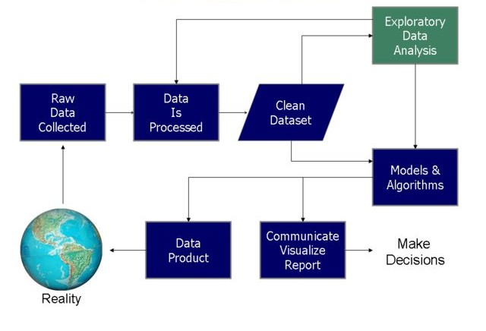
Data Science Process
By Farcaster at English Wikipedia, CC BY-SA 3.0, https://commons.wikimedia.org/w/index.php?curid=40129394

Slide 83
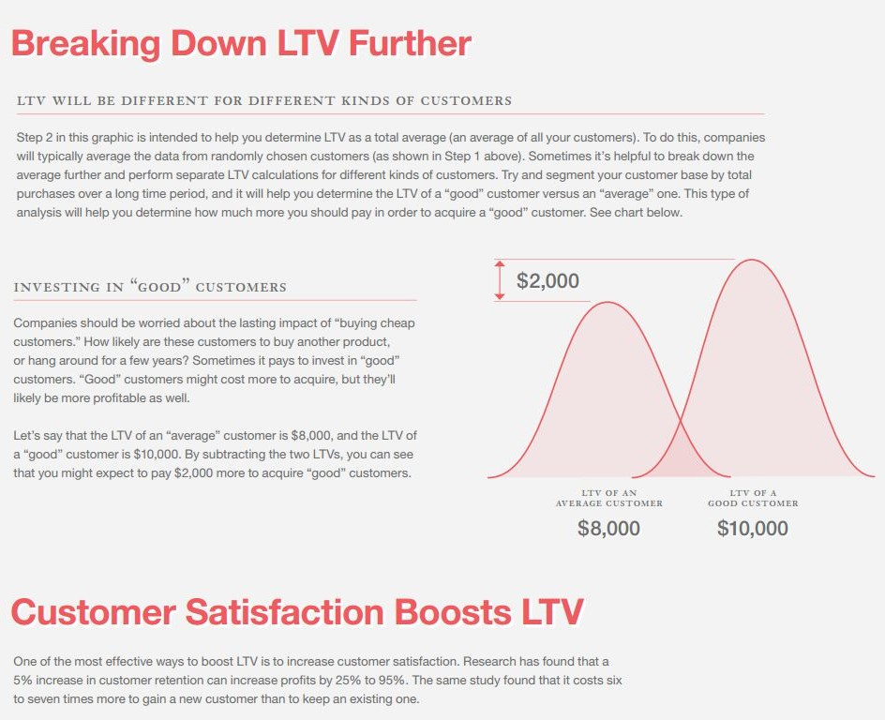
LTV Analytics
Life Time Value (LTV) will help us answer 3
fundamental questions:
Did you pay enough to acquire customers from each marketing channel?
Did you acquire the best kind of customers?
How much could you spend on keeping them sweet with email and social media?

Slide 84
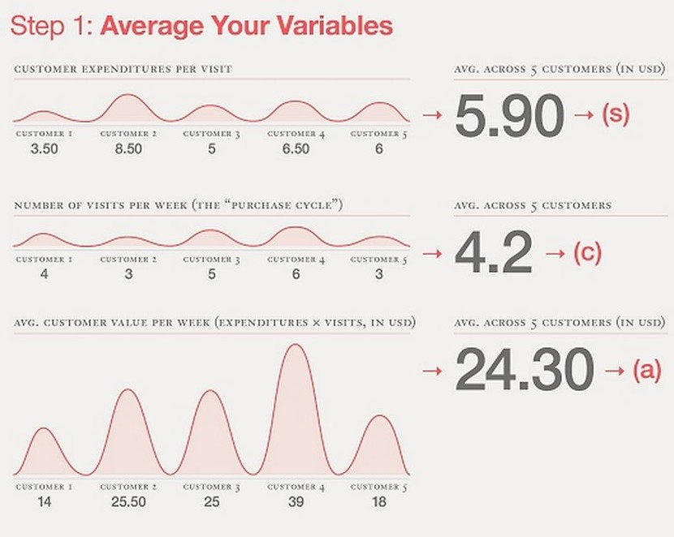
LTV Analytics :Case Study
https://blog.kissmetrics.com/how-to-calculate-lifetime-value/

Slide 85
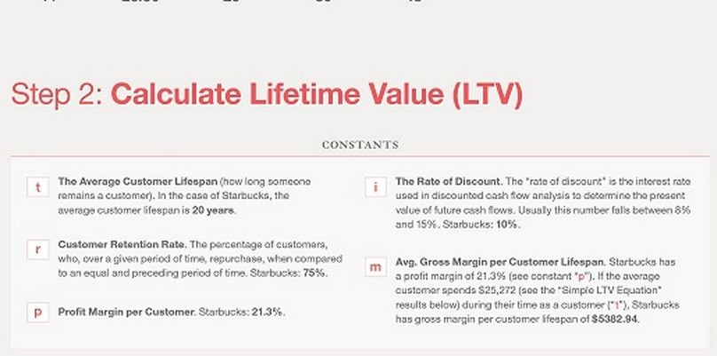
LTV Analytics
https://blog.kissmetrics.com/how-to-calculate-lifetime-value/

Slide 86
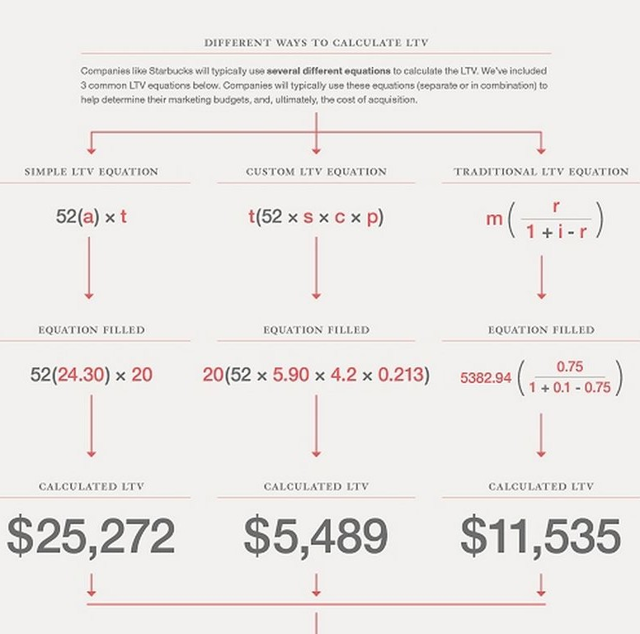
LTV Analytics
https://blog.kissmetrics.com/how-to-calculate-lifetime-value/

Slide 87
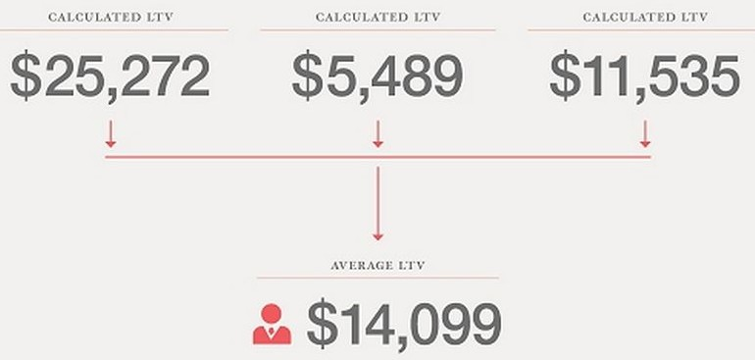
LTV Analytics
https://blog.kissmetrics.com/how-to-calculate-lifetime-value/

Slide 88
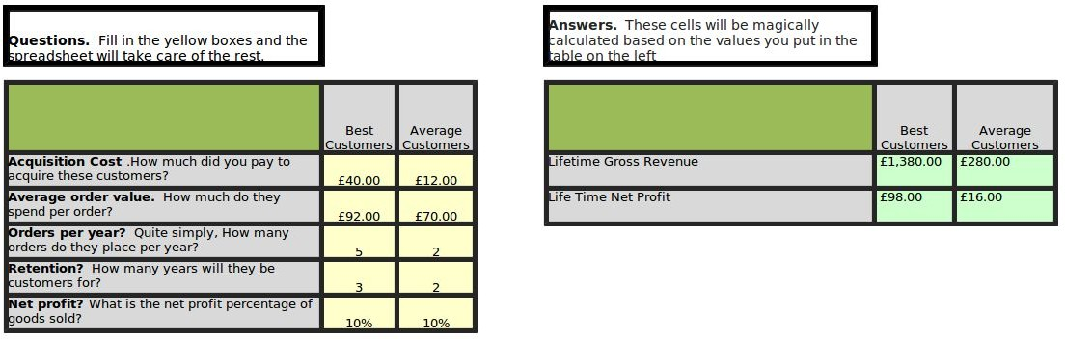
LTV Analytics
http://www.kaushik.net/avinash/analytics-tip-calculate-ltv-customer-lifetime-value/

Slide 89
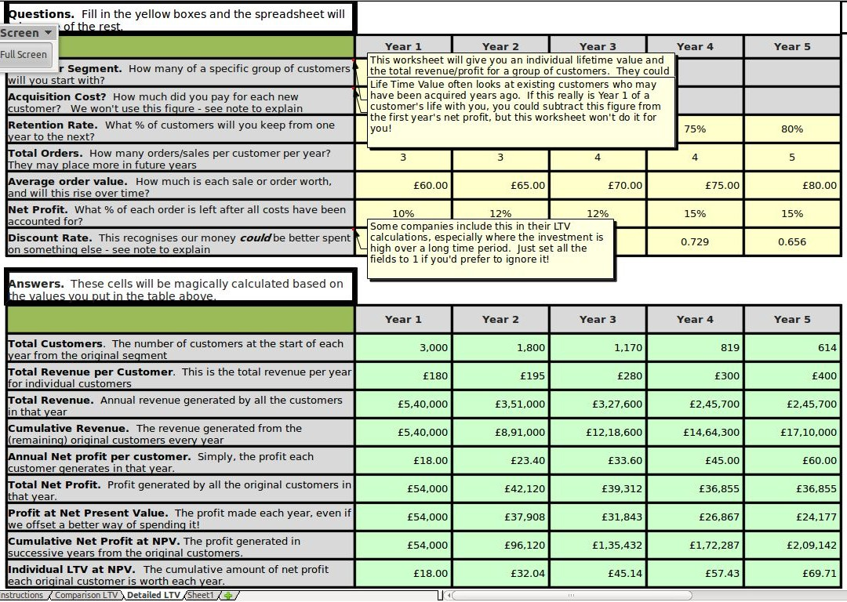
LTV
Download the zip file from http://www.kaushik.net/avinash/avinash_ltv.zip

Slide 90
Pareto principle
The Pareto principle (also known as the 80–20 rule, the law of the vital few, and the principle of factor sparsity) states that, for many events, roughly 80% of the effects come from 20% of the causes
80% of a company's profits come from 20% of its customers
80% of a company's complaints come from 20% of its customers
80% of a company's profits come from 20% of the time its staff spend
80% of a company's sales come from 20% of its products
80% of a company's sales are made by 20% of its sales staff
Several criminology studies have found 80% of crimes are committed by 20% of criminals.

Slide 91
RFM Analysis
RFM is a method used for analyzing customer value.
Recency - How recently did the customer purchase?
Frequency - How often do they purchase?
Monetary Value - How much do they spend?
A method
Recency = 10 - the number of months that have passed since the customer last purchased
Frequency = number of purchases in the last 12 months (maximum of 10)
Monetary = value of the highest order from a given customer (benchmarked against $10k)
Alternatively, one can create categories for each attribute. For instance, the Recency attribute might be broken into three categories: customers with purchases within the last 90 days; between 91 and 365 days; and longer than 365 days. Such categories may be arrived at by applying business rules, or using a data mining technique, to find meaningful breaks.
A commonly used shortcut is to use deciles. One is advised to look at distribution of data before choosing breaks.

Slide 92
